Slide 1
Eventify: ER Diagrams

Slide 2
Team1 : Eventify
List of Entities
Entity Name | Entity Primary Attributes
User | userId, name, email, passwordHash, phoneNumber, role
Event | eventId, organizerId, title, description, category, startDate, endDate, venueId
Venue | venueId, name, address, city, state, capacity
Ticket | ticketId, eventId, userId, price, status, bookingDate, paymentId
Payment | paymentId, ticketId, amount, paymentMethod, paymentStatus, transactionDate
Review | reviewId, userId, eventId, rating, comment, createdTs

Slide 3
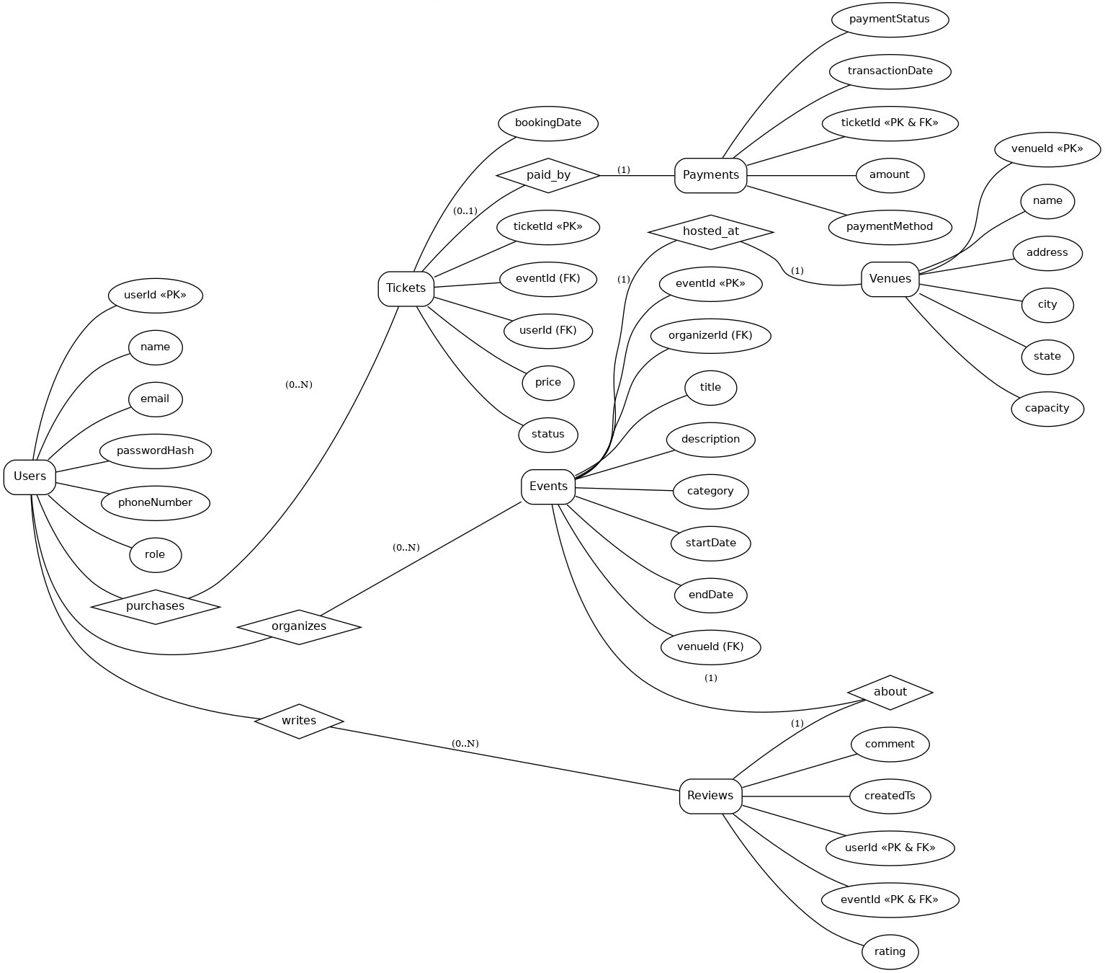
Team1 : Eventify
Conceptual ER Diagram

Slide 4
Team1 : Eventify
Logical ER Diagram
Events
eventId (PK)
organizerId (FK → Users.userId)
title
description
eventTypeId (FK → EventType_Ref.id)
startDate
endDate
venueId (FK → Venues.venueId)
Users
userId (PK)
name
email
passwordHash
phoneNumber
roleId (FK → UserRole_Ref.id)
Tickets
ticketId (PK)
eventId (FK → Events.eventId)
userId (FK → Users.userId)
price
status
bookingDate
Venues
venueId (PK)
name
address
city
state
capacity
Reference Tables
Reviews
reviewId (PK)
userId (FK → Users.userId)
eventId (FK → Events.eventId)
rating
comment
createdTs
PaymentMethod_Ref
id (PK)
methodName
TicketStatus_Ref
id (PK)
statusName
description
isActive
Payments
ticketId (PK, FK → Tickets.ticketId)
amount
paymentMethod
paymentStatus
transactionDate
roleId (FK → UserRole_Ref.id)
EventType_Ref
id (PK)
eventTypeName
PaymentStatus_Ref
id (PK)
statusName
description
isActive
TicketTypes_Ref
id (PK)
role

